Slide 1
MICROSOFT INTELLIGEN SECURITY ASSOCIATION (MISA) MEMBER

Slide 2
Agenda
Copilot for M365 Introduction – Atle Skjekkeland
An Enterprise risk view – Andrew Bentley
Copilot Options Evaluation – Vivek Bhatt
Copilot readiness checklist – Vivek Bhatt

Slide 3
CoPilot for M365 Introduction - Atle Skjekkeland

Slide 4
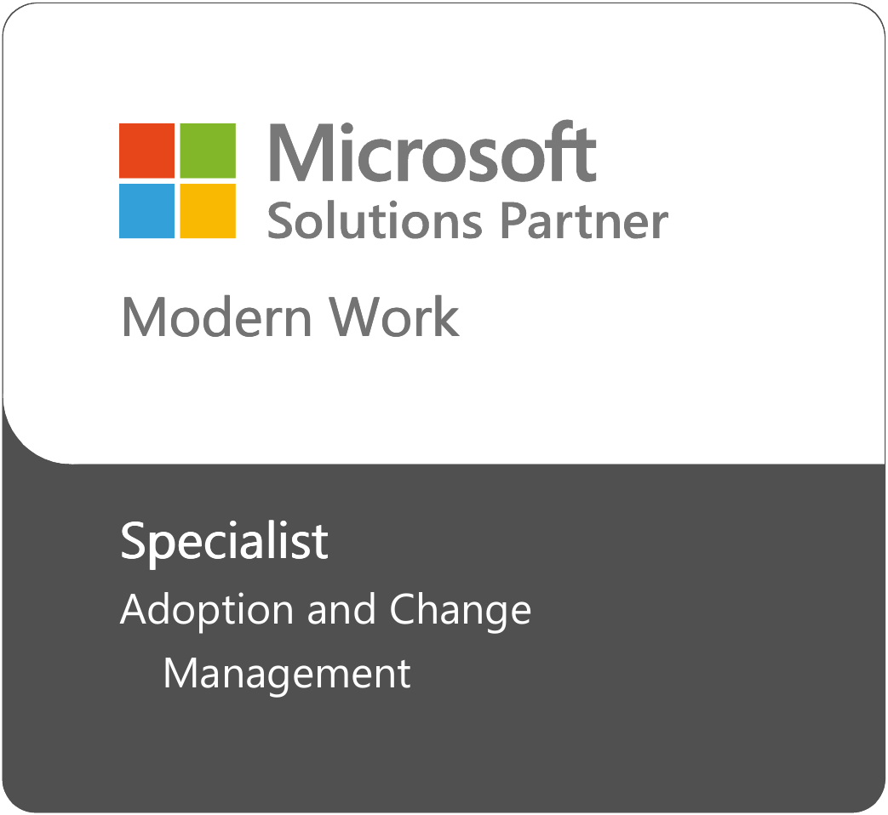
About Infotechtion
Smart Data Security and Governance Solutions for Microsoft 365 and Beyond
Infotechtion was founded by leading Information Governance experts with a vision to modernise information management activities and create value from information. Fast forward to today the company has grown into one of the leading solutions and consulting firms pioneering the application of technology solutions to meet global regulatory compliance requirements.
Our vision is to be a global advisory-of-choice for companies and organisations who desire holistic integrated information Governance maximising the value of information wherever it lives.
Leading Specialists
We combine deep technology knowledge and a proven track record of delivering expertise in privacy & legal regulations to transform your data into a business asset that is protected wherever it travels. Our customers are large enterprises and national government bodies operating in highly regulated environments, and we bring this enterprise experience in our consulting approach.
Information Protection and Governance Specialization to help customers safeguard their entire organization with integrated security, compliance, and identity solutions.
Data Security includes implementing managed services to manage data security threats leveraging endpoint solutions, information protection, data loss prevention solutions and establish policies to protect insider threats.

Slide 5
Generative AI
“In Forrester’s 40 years, we’ve rarely recommended that clients move immediately to build a new technology. We typically counsel cautious experimentation until the tech matures and the vendor landscape rationalizes.
We’re breaking that rule with generative artificial intelligence (genAI). We believe that you must move NOW.
This is the biggest technology/business change of my lifetime, and if you’re in your 40s, it will be one of the two or three biggest of your lifetimes. This change will cause extinction for many, but opportunity and growth for many more. Position yourself not to be a victim. Position yourself to win.”
- George Colony, CEO of Forrester

Slide 6
Generative AI will play a role in 70% of text- and data-heavy tasks by 2025, up from less than 10% in 2023.
Source: Gartner
Image : “The Imitation Game" movie, 2008

Slide 7
Copilot for Microsoft365
Your AI assistant at work
Notes:
In March 2023, Microsoft introduced Microsoft 365 Copilot—your AI assistant at work. For people on the call still figuring out the adoption of M365, please close your ears because Microsoft 365 Copilot brings an entirely new way of working, which transformative aimed at brining efficiencies to modern work, security, governance and many more use cases.
Microsoft 365 Copilot is an AI-powered productivity tool that works alongside popular Microsoft 365 apps used every day, such as Word, Excel, PowerPoint, Outlook, Teams, and more. Every business is learning about the power of AI and it’s important to understand how Microsoft 365 Copilot brings the power of AI into a secure business context.
Microsoft 365 Copilot combines the power of large language models (LLMs) with your data in the Microsoft Graph—your calendar, emails, chats, documents, meetings, and more—and the Microsoft 365 apps .
Copilot is integrated into Microsoft 365 in two ways.
First, it works alongside you, embedded in the apps millions of people use every day.
Now, you can be
More creative in Word,
More analytical in Excel,
More expressive in PowerPoint,
More productive in Outlook and
More collaborative in Teams.

Slide 8
ChatGPT has been shown to improve worker productivity by 37%.
Source: Experimental Evidence on the Productivity Effects of Generative Artificial Intelligence, MIT.
Image : “Office Space” movie, 1999

Slide 9
Gartner Generative AI 2024 Planning survey of 822 business leaders:
15.8% revenue increase
15.2% cost savings, 4.6% through reduction in headcount
22.6% productivity improvement
Image : “Indiana Jones and the Kingdom of the Crystal Skull" movie, 2008
Notes:
Organizations demonstrating early business value from generative AI (GenAI) are
building a portfolio of use cases focused on defending their competitive position
with incremental improvements, extending current processes for differentiation or
upending their industries, core process and business models, but the vast majority of
Gartner client-reported GenAI investments currently fall into the “defend” and
“extend” categories.
Productivity gains are the dominant initial benefits reported by early adopters. Most
outcomes from productivity impact leading indicators of future value as opposed to
direct financial benefit (such as immediate cost reduction). This requires a higher
tolerance for indirect, future financial results versus immediate ROI

Slide 10
GenAI conversational assistants can improve customer service and support agents’ productivity. (studies show a range of 14% to 35% improvement).
Source 1: Will Generative AI Make You More Productive at Work? Yes, But Only If You’re Not
Already Great at Your Job, Stanford University Human-Centered Artificial Intelligence.
Source 2: Erik Brynjolfsson, Generative AI at Work | NBER
Image : “Little Britain” series

Slide 11
Securing AI

Slide 12
Copilot for Microsoft 365 is transforming work
60%
68%
of leaders say a lack of innovation or breakthrough ideas is a concern
said Copilot improved the quality of their work
64%
70%
of people have struggled with finding time and energy to get their work done
said Copilot made them more productive
70%
77%
of people indicated they would delegate as much as possible to AI to lessen their workloads
said they didn’t want to give Copilot up
Work trend Index Annual Report: Will AI Fix Work? Microsoft. 9 May 2023 | Microsoft Work Trend Index: What can Copilot’s Earliest Users Teach Us About Generative AI at Work?: Microsoft. 15 November 2023
Notes:
The pace of work has increased exponentially—along with the crush of data, information, and always-on communications. People are struggling to shoulder the weight of it all, while business leaders feel pressure to increase productivity amid economic uncertainty. The intensity of work and always-on communications are outpacing our ability to keep up.
AI is poised to create a whole new way of working. In March we introduced Copilot for Microsoft 365. For many, the platform shift to AI is already underway. Organizations that embrace AI will unleash creativity and unlock productivity for everyone—ushering in a new wave of productivity growth and value creation.
The feedback we are receiving and the data we are collecting from Copilot’s earliest users underscore that fact. 68% said Copilot improved the quality of their work, and 70% said it made them more productive; with 77% saying they wouldn’t want to give Copilot up.

Slide 13
Concerns we've heard from you...
Lack of visibility
Lack of protection
Increased AI regulations
58% of organizations
97% of organizations
By
2027
are concerned about the lack of visibility into the unsanctioned use of GenAI².
have concerns about implementing AI due to the lack of controls to mitigate risks of data leakage³.
at least one global company will see its AI deployment banned by a regulator for noncompliance with data protection or AI governance legislation⁴.
Notes:
But with all the benefits of AI, come some risks and some new challenges. In fact, based on a recent Microsoft Security survey, here are some top challenges when managing data risks generated by AI apps:
Lack of visibility into risks: 58% of organizations are concerned about the lack of visibility
Lack of controls to protect data shared in AI: another critical concern is data security; how do security teams ensure that any sensitive data that’s been exchanged between the user and app is protected? 97% of organizations have concerns about implementing AI due to the lack of controls to mitigate data leakage.
Increased regulatory pressure: with the rapid adoption of AI in business workflows, it’s important that security teams remain compliant and can keep up with new regulations that come around data protection

Slide 14
Along with using AI to empower our world, we must also secure AI
Poll: Which Risks of GenAI Are You Most Worried About?
Secure AI
Securely develop and deploy for safety, trust, privacy, and data integrity
Source: Gartner IT Executive Webinar Poll (August 2023), n=713
Notes:
And this leads me onto the discussion we are having now with a lot of customers due to the general availability of Copilot for Microsoft 365 and the availability & appetite of customers to want to leverage Generative AI capabilities in their business. The desire of the boardroom to innovate and gain competitive advantage vs. the security concerns of the access that people can have to data inside their business and what Generative AI could expose in terms of access to information within that organisation.
This risk balance and tension is holding organisations back. But as Vivek will illustrate later on there is value in deploying Copilot for M365 quickly and ensuring that you give access to certain users and data to generate efficiences, and value realisation, whilst at the same time working on your data security strategy for broader roll out and adoption.
You can see from this Gartner IT Exec survey from August that Data Privacy is the no. 1 concern for organisations when it comes to Gen AI
This is a critical initiative that Microsoft started many years ago with the beginning of our AI journey.
It is vital that we all understand how to securely develop and deploy AI-capable solutions for safety, trust, privacy, and data integrity

Slide 15
Security and compliance challenges
1
2
3
Data oversharing:
Users may access sensitive data via AI apps they’re not authorized to view or edit
Data leak:
Users may inadvertently leak sensitive data to AI apps
Non-compliance usage:
Users use AI apps to generate unethical or other high-risk content
Project x
COMPLIANT
Notes:
So what are we hearing that Organisations are worried about when it comes to Data Security and privacy when it comes to the use of Generative AI:
Let's delve into the real challenges organizations are currently facing by examining some common risk scenarios.
Firstly, organizations lack visibility into the usage of AI applications, including information on which apps are being used, who are the users using these AI apps, and the types of data shared with and generated by these apps. Insufficient visibility into usage can give rise to security and compliance challenges, potentially leading to incidents such as:
Data oversharing: Users might attempt to access sensitive information, such as confidential projects or personal data, through AI apps like Copilot. Without appropriate data security controls, these AI apps could gain access to, summarize, or create content based on sensitive data, increasing the risk of data overexposure or oversharing.
Data leaks: Users may inadvertently disclose sensitive data, such as customers’ personal data, to AI apps, like consumer services such as ChatGPT. This concern is prevalent in headlines and echoed by other organizations. This is less relevant for Copilot for M365 since it comes with built in controls.
Non-compliance usage: With the ease of content creation using generative AI, users can effortlessly generate new content, including unethical or high-risk content such as fake news, fraudulent content, or stock manipulation. It is imperative for organizations to govern the usage of AI apps, ensuring compliance with codes of conduct and regulatory requirements.

Slide 16
Effective data security is a pre-requisite to deploying AI responsibly
“Less than half (47%) of CIOs and technology leaders say they are confident that their organization will be able to mitigate the risks of AI.”
– Gartner, We Shape AI, AI Shapes Us: 2023 ITSymposium/Xpo™ Keynote Insights, Mary Mesaglio, Don Scheibenreif, Hung LeHong, et al., October 2023
Notes:
So to mitigate these risks,you need to properly secure and govern the data used and produced by AI
And, as this other Gartner insight showed from October, today less than half (47%) of CIOs and technology leaders are confident their organization will be able to mitigate the risks of AI
That is because the new risks that come with implementing and deploying AI are not fully known

Slide 17
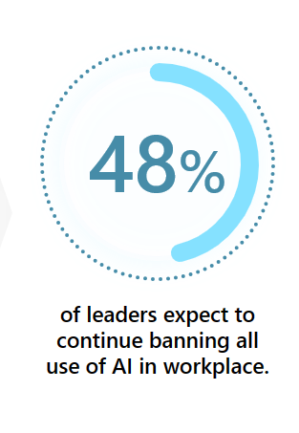
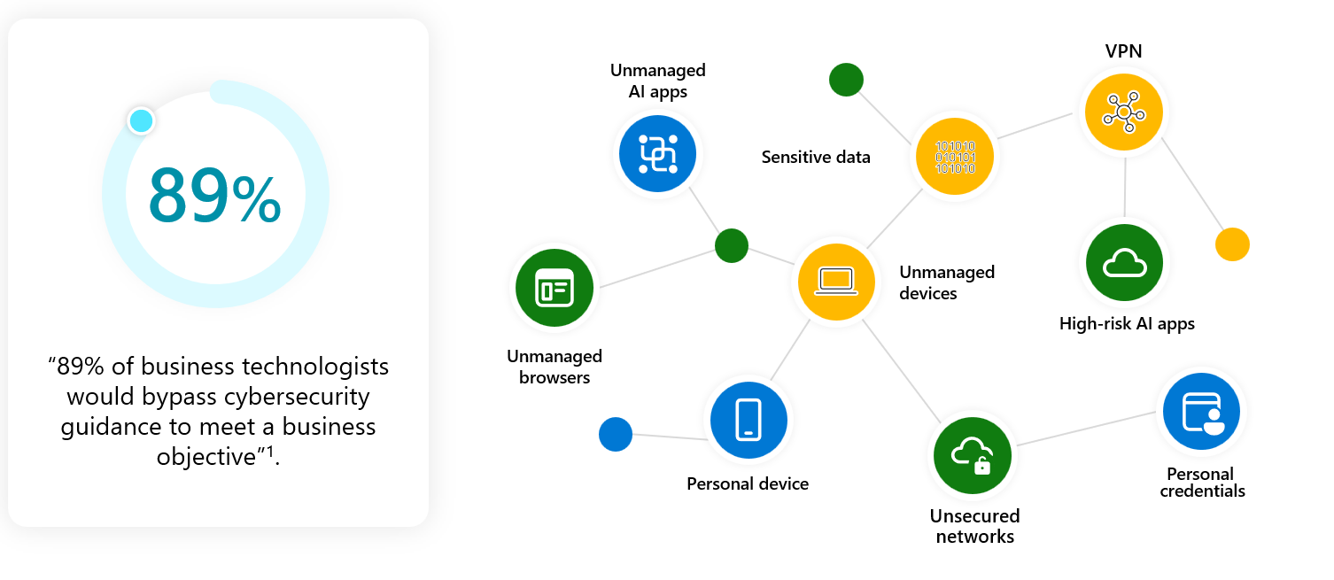
Shadow AI can bring more dark usage
* % of CISOs and Security Decision Makers (ISMG First Annual Generative AI Study: Business rewards vs. Security Risks)
¹ Gartner®, Infographic: Build Business Technologists' Cyber Judgment to Improve Risk Decision Making, 23 March 2023. GARTNER is a registered trademark and service mark of Gartner, Inc. and/or its affiliates in the U.S. and internationally and is used herein with permission. All rights reserved.
Notes:
With all these concerns, almost half of the security leaders surveyed expect to continue restricting all use of AI in the workplace. And that is not really the best way to address the perceived security risks
When users are prevented from using their preferred technology, we often see an increase in risky behaviors, not a decrease. This is similar to the trend when Software as a Service (SaaS) started gaining popularity. Almost 90% of business users given a choice will side-step cybersecurity controls to achieve their business goal. And, when users are restricted from utilizing AI applications, they will look for alternative ways to access and use these apps.
For example - users might use AI apps through their unmanaged devices, over unsecured networks, or by logging in with personal credentials while handling sensitive data. These types of behaviors lead to an increase in what we call "dark usage" - which is usage that the IT and security teams are not able to monitor or control. And this introduces even more unknown risks to your organization.
You are left with 2 choices – either try and block Gen AI usage in your organisations (note that this choice will lead to Shadow AI and unregulated and insecure usage in your organisation)
Or provide your end users with access to Generative AI capabilities from applications and vendors that you trust, have security built into them, and can monitor usage and effectiveness
First - Over 80% of leaders share that the potential for sensitive data leakage is their primary concern. There's a real need for organizations to improve the visibility and control over their most critical asset - their data!
Second - Is the concern of overreliance on AI and risky content that may be created by generative AI. More than 70% of leaders worry about inaccuracy of responses and almost 60% worry about harmful, biased, or distressing outputs.
Third - With regulations, such as the EU AI Act, on the horizon, leaders face increasing regulatory pressure. And, 55% of these leaders lack the understanding of the upcoming regulations and how best to respond to them.

Slide 18
What’s the current state? How secure is the AI usage in your organization?
Who’s using AI applications?
Are AI outputs and interactions protected and well-governed?
What types of sensitive data are flowing into AI interactions?
AI
apps
JPG
What types of AI apps are being used in your organizations?
Notes:
Instead of restricting AI or turning a blind eye to it, security teams can more effectively mitigate these risks by gaining insights into what is happening in the organization. This reduces what we call generative AI-nxiety. 😊
Visibility into how AI is being used allows you to directly confront and manage risks that may arise. Without this proactive approach customers become uncertain of where the next risk may come from. When you think about understanding your risk in adopting generative AI applications, there are a few basic questions to start with:
Which AI applications are being utilized by users?
Who is using these AI applications, and how is access being governed?
What type of data is flowing both in and out of those AI applications?
Also – critically – what are the AI principles and security built within these applications, who is the vendor/supplier that has built out the AI application itself?

Slide 19
Microsoft’s AI Principles
Microsoft Cloud — AI you can trust
Fairness
Reliability & Safety
Privacy & Security
Inclusiveness
Your data is your data.
Your data is not used to train the OpenAI foundation models without permission.
Transparency
Your data is protected by the most comprehensive enterprise compliance and security controls.
Accountability
Notes:
Before I jump in: the topic I hear most: data protection, security, and privacy.
AI development guided by our RAI ethical framework.
We’ve built these principles directly into Copilot orchestration.
Your data is your data, to own and control.
Microsoft doesn’t use your data to train the LLM.
Your data is protected by the most comprehensive enterprise compliance and security controls.
This last point is probably one of the most critical: protecting your data.

Slide 20
Copilot for M365 honours your current protections for data at rest and data in transit
Manage SharePoint permissions
Classification Labelling
Create a DLP policy
Review SharePoint site permissions to ensure sensitive sites are only accessible by sanctioned individuals to perform their day-to-day duties.
Leverage label taxonomy and label content by enabling default labels, configuring manual labeling, or scaling with auto-labeling
Create DLP policies and prevent content oversharing through M365 apps, devices, and in browsers
Build a foundation for data security and compliance
Notes:
So ensuring that you use secure Gen AI apps from reputable vendors who have invested in responsible AI foundations and secure development to give you confidence in the security of the tools that you are using is absolutely key, but its also important to remember that this is only 1 part of the story - you need to remember that these tools themselves take on the protections you have in place for your users – and this is what Vivek is going to talk to you more about now, how do you put the governance and processes in place around the use of Copilot in your organisation and also ensure you have the robust and effective data security strategy you need to maximise value from these tools and minimise risk,
One last message to leave you with - the tools themselves are only part of the Security story, the other side is the data governance, data policies and data security you already have in place within your organisation. Remember that Copilot for M365 just takes on the current protections and policies of the users using it!
-the message is that our controls haven’t changed
- your current controls for data at rest haven’t changed, and this is what will decide what can and cannot be surfaced
- we are still relying on site permissions and sensitivity labelling – - M365 Copilot will honour all current controls you have in this space.
- the other control plane we need to consider is to ensure sensitive content cannot be overshared.
the control layer for data in transit is still DLP
- ultimately what we are talking about are the foundations of good data hygiene
- we should know where our most valuable assets are,
- and if we are really concerned about data getting in front of the wrong people
- we should have that data controlled, at rest and in transit.
- CLICK

Slide 21
Copilot Options Evaluation

Slide 22
How Copilot for M365 gets its information.
Microsoft 365 Tenant Boundary
User Prompt
Copilot for M365
Microsoft Graph
Response
Messages
Meetings
Chats
Large Language Model
File sharing
User
Calendar
Microsoft Bing
Notes:
User initiates a prompt from a Copilot for M365 enabled interface. “What is the help desk number?”
Copilot uses the Microsoft Graph and Semantic index to find organizational information the user has access to.
Relevant organizational information in M365 apps is returned to Copilot, which is then send to LLM
LLM generates a response and returns to Copilot for presentation.
Well, if Bing chat for enterprise is enabled (which is by default), Copilot will reference public web content in response through Bing. This involves sending organizational data outside of your Microsoft tenancy.
Finally a response is send back to the user. Example: response to a prompt in Microsoft Teams chat.

Slide 23
AI adoption
Understanding the AI options
Microsoft Copilot
Bing Chat Enterprise
Microsoft 365 Copilot
 | Personal | Work | Work
Availability | Available now | Available now in Business Standard/Premium, E3/E5 | GA in 2024 Business Standard/ Premium and E3/E5 are prerequisites
GPT Large Language Model
AI-powered web search, answers, and content generation
Commercial data protection
Microsoft 365 enterprise security, compliance, and privacy
Microsoft 365 Graph (content and context)
Microsoft 365 apps
Notes:
Let’s take a step back to compare the AI options offered by Microsoft.
Bing Chat is powered by GPT-4, Open AI’s most capable model.
This is what gives it the ability to reason over data. ​It offers AI-powered web search, and answers – complete with citations so you can verify answers.
Opinion: Most security conscious organisations are either blocking access or looking at measures to prevent organizational information being transferred by users into Microsoft Copilot.
Bing Chat Enterprise adds commercial data protection. As you heard, this means your data won’t leak or be used to train the models. However, even though your prompts are not stored, the processing of data happens outside of M365 tenant boundary. We recommend that you evaluate your privacy assessment in regards to Bing chat for enterprise.
Opinion: Organizations are opting to disable until a privacy risk assessment is completed and satisfactory to meet privacy obligations.
Microsoft 365 Copilot takes it to a whole new level.​ It has all the capabilities of Bing Chat Enterprise, ​plus so much more. It has the powerful GPT large language model, AI-powered web search and answers. Our conclusion is that M365 Copilot alone (without BCE) is a powerful, enterprise ready solution and does comply with your privacy requirements by working within your tenant boundary.
Opinion: Organizations are opting to pilot for specific use cases, especially in favor of offering employees a capability which otherwise will drive them to other open generative AI solutions not suitable for enterprise compliance and security.

Slide 24
Copilot for M365 Facts
Teams Chats with Copilot are persistent
Large Language Model training
Both prompts and responses persist.
Copilot’s underlying LLM was trained on public web data up until September 2021.
Your Data is Your Data
BCE* is not covered by MS EU data boundary commitment
No additional or elevated access required for Copilot to enrich large language models available in your subscriptions.
When Copilot sends a search query to Bing, organizational data that the user can access is sent outside of your Microsoft 365 tenancy.
Chat Data is not used to train the model
Copilot can access ‘Anyone’ sharing links
Chat with Copilot data is not used to train the Large Language models used by AI
Copilot can form responses from data shared with ‘user delegated access’ , ‘Anyone’ or ‘Anyone in the organisation’ sharing links.
* BCE = Bing Chat for Enterprise
Notes:
Like ChatGPT, the model does not know about events that have happened since that date. Ask Copilot, “Who won Wimbledon in 2023?” and the LLM cannot provide an answer. To get around this limitation, the M365 Chat experiences in Copilot have an integration with Bing, which is enabled by default. If Copilot determines that current web content will improve the quality of the response, it will generate a search query to Bing. Using the results from the Bing search engine, it can then provide up-to-date answers. Users must enable the “external links” toggle In Copilot’s M365 Chat interface before Copilot can use Bing’s search. They can only do this if the setting is enabled at the tenant level (which it is by default).
When Copilot sends a search query to Bing, the user and tenant ID are not included in the search. However, organizational data that the user can access will likely be included. This data is sent outside of your Microsoft 365 tenancy.
Bing is not covered by Microsoft’s EU data boundary commitment nor any agreement that requires company data to remain in a geographic area or tenant boundary. This is significant. If you accept the default settings, and allow M365 Chat experiences in Copilot to search Bing for current web content, there is a risk that sensitive organizational data could leave your tenancy.

Slide 25
Key Emerging Risk Options to Evaluate.
01
02
03
Source of Information to CoPilot.
Confident Inaccuracy
Content Sprawl
Notes:
Oversharing:
Logging in as a user who had never accessed a Public team nor had worked on any document in the team, we asked Copilot through the M365 Chat interface in Microsoft Teams “What documents is Alex Vaughan working on?” Copilot responded with a link to the HR policy document, and of course I was able to access the document because it is in a public team.
Confident Inaccuracy:
We then asked copilot questions about the HR policy, and it gave confident responses based on multiple versions of the policy available between ‘Alex’s’ onedrive and public team. This is also an example of confusion based on duplicate copies of data. If you retain redundant and obsolete data, there is a risk that Copilot or search will find it. However, because Copilot will summarize the content into a confidently written answer, the original source may not be immediately obvious. When compared to Microsoft search, you can see that response also includes the location, and often that is an important factor we all apply to trust a source when it is stored in onedrive vs team vs sharepoint site.
Content Sprawl:
Copilot will lower the barrier to entry for the creation of self-service but more complex Microsoft 365 objects, and it will certainly make it easier to create new content. However, if left unchecked without lifecycle management controls, data security controls, this net new content will generate significant more data.
To give you an idea, on an average workday, Microsoft customers add over 2 billion new files to Microsoft 365 through user generated content, migrated content and content received from other sources.

Slide 26
L
M
H
Copilot Risks
Risk Based Adoption of Use Cases
H
L
L
M
H
Draft a new document based on key points
Email Summarization
Teams' meeting / Transcript Summarization
Discover Corporate Knowledge
Get answers for specific and complex questions
Turn 5 bullet points to a comprehensive document.
Interrogate a long-threaded email and quickly understand the context, key points discussed.
Generate notes, actions, key topics, potential scenarios and even suggestions on follow-up questions.
Chat with Copilot AI assistant to learn more about topics which matter to you and be effective in your role.
Elegantly handle questions that require multiple data points or a degree of analysis

Slide 27
Options to Consider
Foundational Governance
AI-risk readiness Options
Assess your risk exposure
Measure across following aspects as a baseline:
Data Oversharing
Discovery of Sensitive Content
Access Governance for personal and shared workspaces
Pilot with Low-risk scenarios
Enrich your Copilot experience by enabling low risk experiences for your users especially scenarios with high value and low risk of data exposure.
Establish controls to securely govern AI generated content
Start with a Generative AI acceptable use policy, support users with ‘prompt engineering’ training. Enforce lifecycle policies
Notes:
Start by establishing standard baseline governance in Microsoft 365. Businesses who move their data to the Microsoft cloud will be better positioned to harness AI’s transformative potential.
The next step involves protecting your sensitive business data from accidental leakage and content oversharing, ensuring users have the right access to the right internal content. This is a good opportunity to implement good data governance policies and practices.
The final step involves educating and empowering employees before opening secure, AI-powered tools for business-as-usual work.
As you prepare for this final step:
Ensure devices and browsers are managed and secured
Drive change management through AI readiness, and eventually drive adoption through use cases.

Slide 28
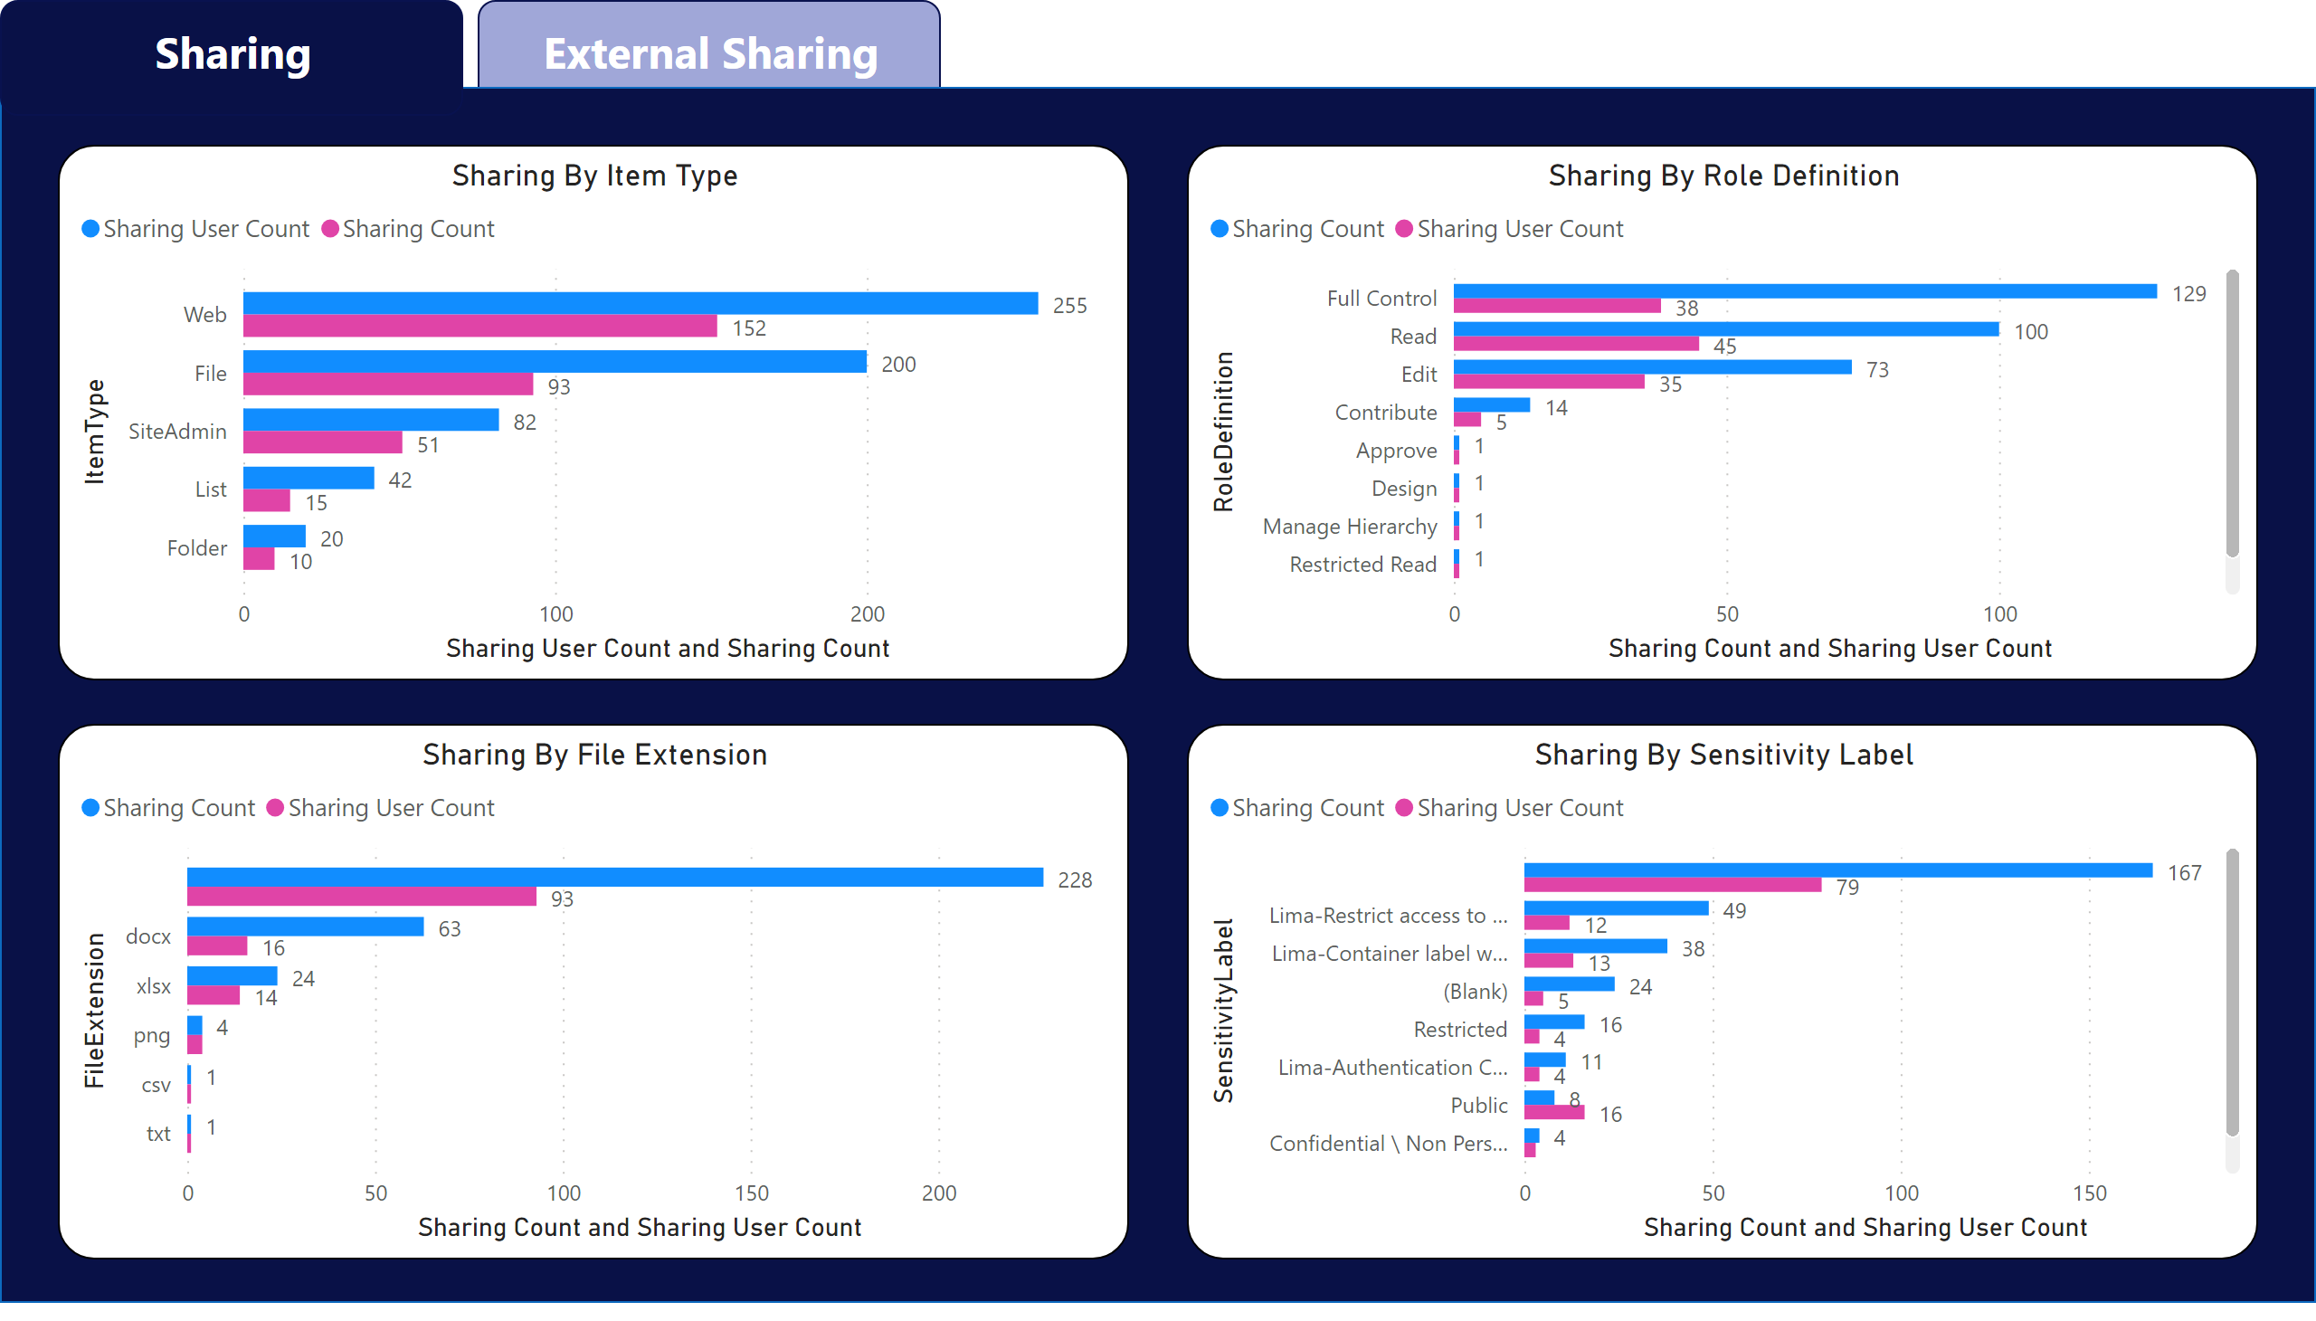
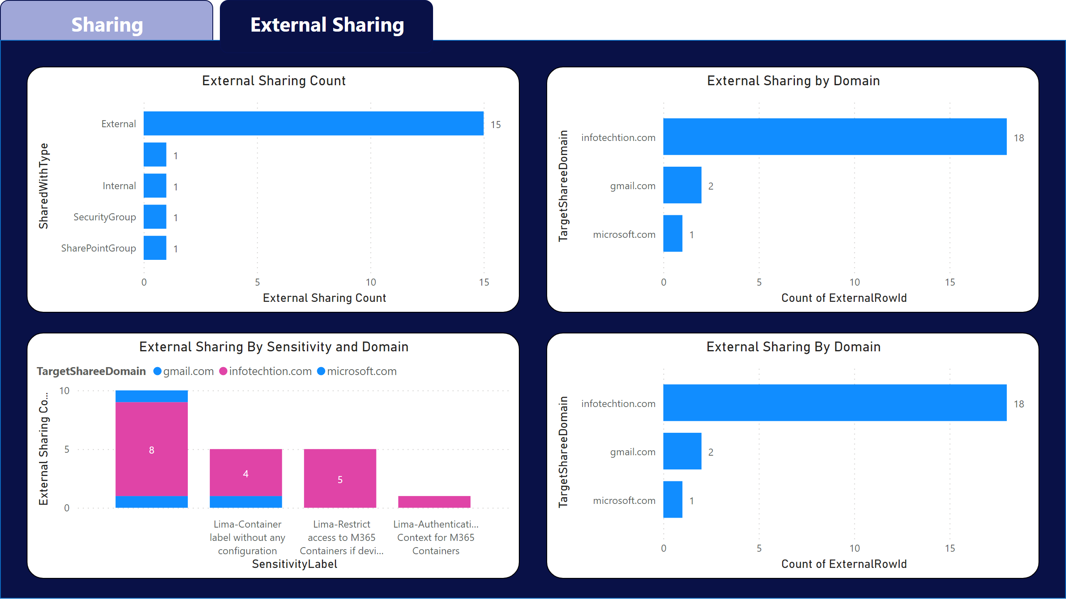
Information Oversharing Dashboard
By looking at the Sites, Permissions and Groups datasets, you can understand if your content is properly protected.
Here are a few common questions that you will be able to answer:
Is oversharing happening?
Is external sharing happening?
Is sensitive data being shared?
Howe much sharing per sensitivity label?
Is sensitive data shared with external users?
What external domains are being shared with?
Which sites have been shared the most?
What roles (levels of sharing) are being used?
What permissions does a specific user have?
What file extensions are most shared?
How much sharing happens at the Web, Folder, List or File level?
A combination of any of the questions above…

Slide 29
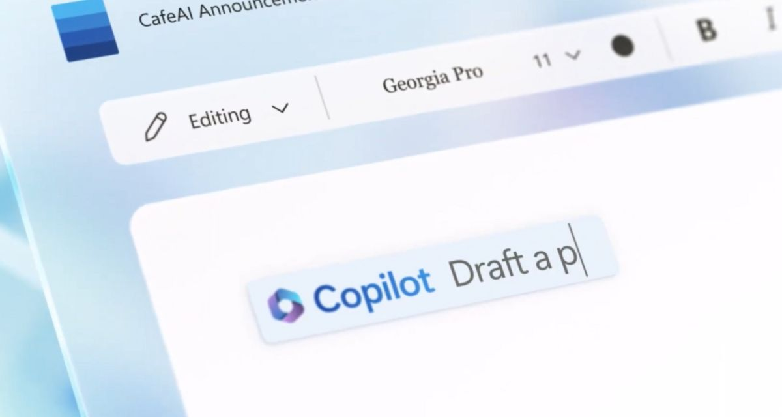
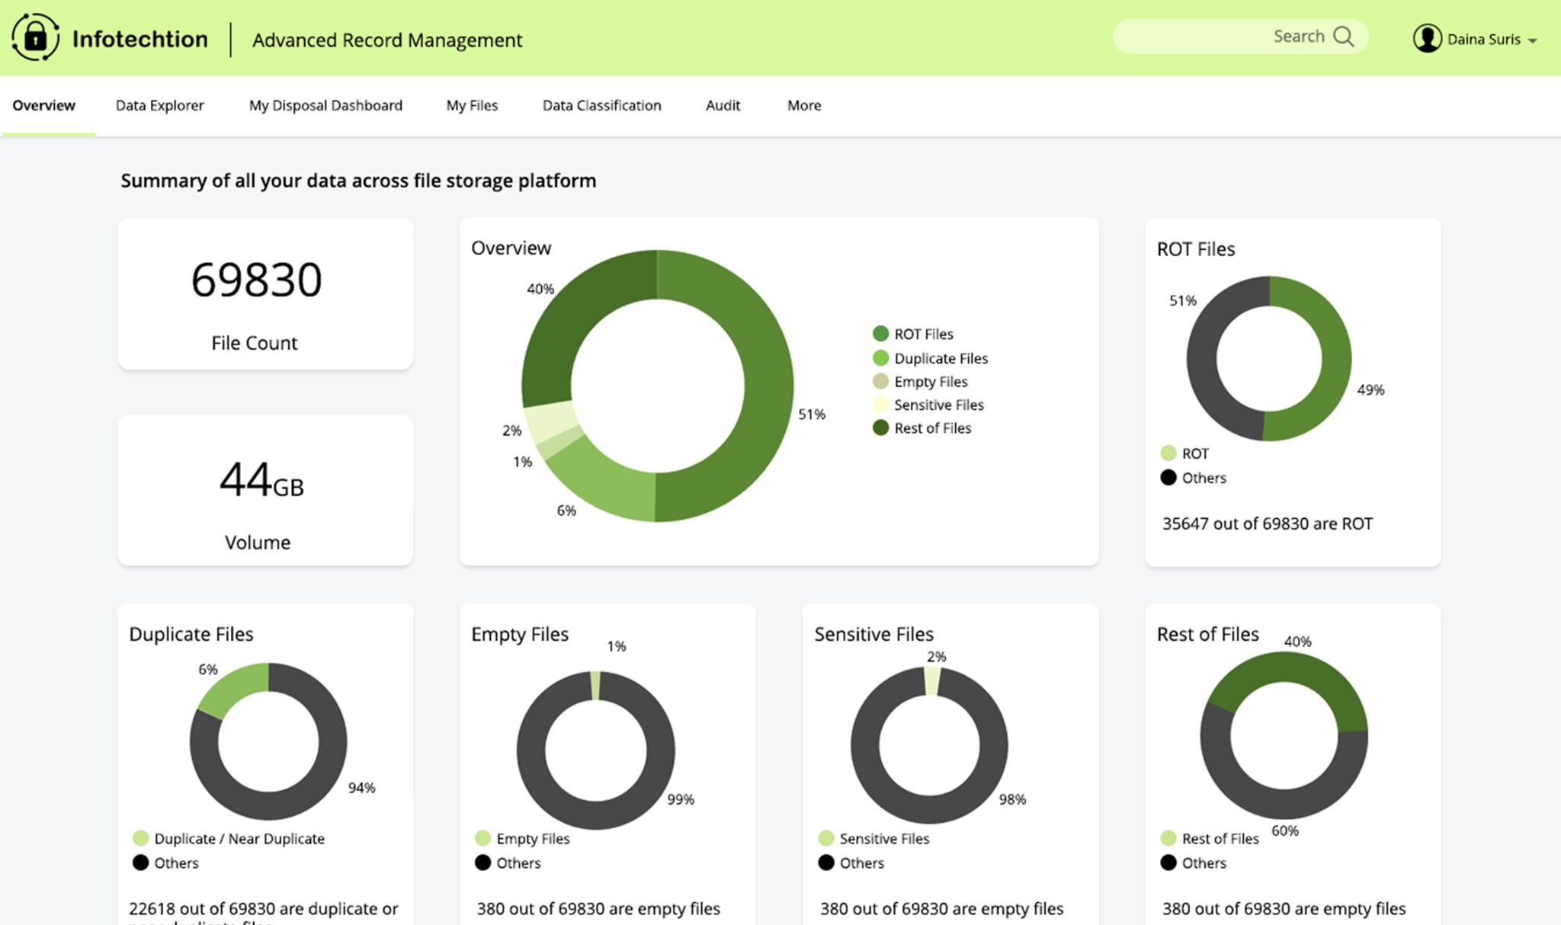
Co-Pilot and I-ARM
Co-Pilot for M365
Infotechtion-ARM for Microsoft Purview
Co-pilot offers features that streamline tasks, automate workflows, and enhance collaboration. Also accesses data across Microsoft 365 services, so ensuring your customer’s security measures are up to par is crucial to prevent data breaches .
Extends the Microsoft Purview disposition process to enable many user-friendly disposition and reporting capabilities.
Main Benefits:
Seamlessly integrated with Microsoft 365 and other popular apps, making it easy to access your files and data from anywhere.
Automatically inherits all your company’s valuable security, compliance, and privacy policies and processes.
Main Benefits:
Aggregates records and presents them to users on predefined schedules for disposition decisions.
Supported via email and dashboards and can involve thousands of records to be disposed of or have their retention lives extended simultaneously.

Slide 30
Copilot readiness checklist

Slide 31
Infotechtion Recommendation
01
Foundational Governance
Get AI-ready checklist
Standardize onto Microsoft 365
Enrich your Copilot experience by getting your data into the Microsoft 365 Cloud.
Protect sensitive business data
Protect internal data from accidental leakage. Ensure users have the right access to the right internal content.
Empower employees with secure, AI-powered tools
Start with a Generative AI acceptable use policy, support users with ‘prompt engineering’ training.
Notes:
Start by establishing standard baseline governance in Microsoft 365. Businesses who move their data to the Microsoft cloud will be better positioned to harness AI’s transformative potential.
The next step involves protecting your sensitive business data from accidental leakage and content oversharing, ensuring users have the right access to the right internal content. This is a good opportunity to implement good data governance policies and practices.
The final step involves educating and empowering employees before opening secure, AI-powered tools for business-as-usual work.
As you prepare for this final step:
Ensure devices and browsers are managed and secured
Drive change management through AI readiness, and eventually drive adoption through use cases.

Slide 32
Copilot readiness checklist
1. Manage ‘Anyone’ / ‘Open Access’.
2. Automation of classifying existing M365 data.
3. Automate Data lifecycle management workflows to delete ROT, temp, duplicate data.
Notes:
Review M365 sharing settings and remediate your access control configurations:
Report on ‘open’ permissions
Evaluating permission risks
Managing permissions and access, offering solutions for automating least privilege access
How to ensure continuous readiness through ongoing monitoring
Strategically discover and plan best ways to automate the protection of your “crown jewels”:
Start with mandatory sensitivity labels and policy tips to educate users to classify data as per its sensitivity.
Automate classification of existing data which may include Sensitive Information Types (SITs), Trainable classifiers, default labels
Implement methodologies to ensure lifecycle management is ‘hands-off’ and not a worry:
Leverage M365 tools
Introduce other options to ease in the disposition process
Provide a unified view of ROT, duplicate, and expired data, automate its lifecycle management.

Slide 33
Copilot readiness checklist
4. Actionable insights to manage new sensitive data generated by users / AI.
5. Educate co-pilot users for ‘prompt readiness’.
Notes:
Harnessing the tools to bring insights to life - surfacing action items for managing new sensitive data
Combine Power BI reports with workflow integration to surface signals from Log Analytics, Sentinel, and Unified Audit log
Provide comprehensive prioritised action items
Education is key – training end users and pertinent subject matter experts
To alleviate any concerns of how AI works and what it is doing – offer training to raise awareness and bust AI-myths
Ensure all SMEs are educated and informed based on their role so any concerns (e.g., privacy, legal) are addressed.
Generative AI is creating need for a new kind of training, its called ‘prompt engineering’ . The art of asking the question to get an appropriate response.

Slide 34
CoPilot Adoption Journey – A Case Study
Benchmark Configurations
Tenant security settings scan.
Data security and oversharing risk report.
Stakeholder survey.
2 day Use case discovery workshop.
Configure Pre-requisites
License and infrastructure.
Minimum software versions.
Switch ON/OFF capabilities.
Recommended policies to monitor Copilot.
Activate Use Cases.
In-App activation for selected users and apps.
Baseline security policies dedicated to Copilot interactions, Gen-AI content.
KPIs to measure operationally.
Outcome
i-ARM advanced insights for Copilot and Purview
Data governance workflows for managing risks.
Current state
prepare
implement
govern
- p
Tenant Readiness (Scans)
Essential components required
Design controls for labelling data & DLP
Gen-AI content lifecycle
Production configuration, business change.
Standard Operating Procedure
Findings recommendations and next steps
Case for Copilot
Risk Maturity
Copilot deployment plan
Enterprise readiness check
Handover findings
Assess & Understand
Baseline & Target
Alignment & Adoption
Enterprise-Wide Readiness

Slide 35
In Summary..
01
02
Foundational Governance
Microsoft 365 Copilot
Notes:
M365 Copilot is built on your foundational governance, the quality of your data, the implementation of your governance, and your approach to modern way of working with digital information.

Slide 36
Microsoft 365 Copilot
Final Thought
Assess your business content and context
Review data governance policies, protect sensitive organizational data, and prevent content oversharing. Microsoft Purview allows you to:
Implement identity governance baseline to avoid data over-exposure.
Apply sensitivity labels or restrict permissions in Microsoft 365 apps by using Information Rights Management (IRM)
Set up retention labels and policies for Copilot interactions
Notes:
The more powerful the information retrieval tool, the more critical it is to have effective information governance controls and permissions management.

Slide 37
Call to Action
Unlock Microsoft 365 Copilot
Foundational Governance
Drive change management and user skilling on AI.
Establish a generative AI acceptable use and governance policy.
Opportunity
Remediate workspaces and overshared content identified as risk.
Design and implement foundation governance with Microsoft Purview
Design a mandatory sharing, and prompt engineering training.
Copilot readiness assessment with automated tenant assessment, delivering:
Tenant oversharing report (internal – external sharing).
M365 identity governance benchmark against recommended configurations.
Recommended action plan for Copilot readiness.
£2k
Notes:
Note: To qualify for the Copilot readiness assessment an organization must have a minimum of 20 licensed users for M365 Business Premium or equivalent qualifying subscription for Copilot.
The assessment doe not require any end user engagement and is purely technical to perform a scripted analysis of your tenant configuration, and link sharing risks.

Slide 38
Thank you
VIVEK.B@INFOTECHTION.COM / MARIA.L@INFOTECHTION.COM
https://INFOTECHTION.COM/

